Slide 1

Understanding Path and Class Path in Java
Presented By Jyothi.E

Slide 2

Contents
> Introduction
- Path
- Class Path
> How to set Path
> How to set Class path
> Path Vs Class Path

Slide 3
Introduction
what is Path and Class Path
Both Path and Class Path are environmental variables in java.
To find the location of files.
Path => Helps to OS to find executable files.
Class Path => Helps the class loader to locate the class files.
NOTE : In IDEs like Eclipse, no need to set path to compile and run the java programs

Slide 4
How to set PATH
Path :
Path is an environmental variable used to find and locate binary files like “java” and “javac”.
We can set the path in two ways:
1. Through command prompt (temporary)
2. Through environmental variables (permanent)

Slide 5
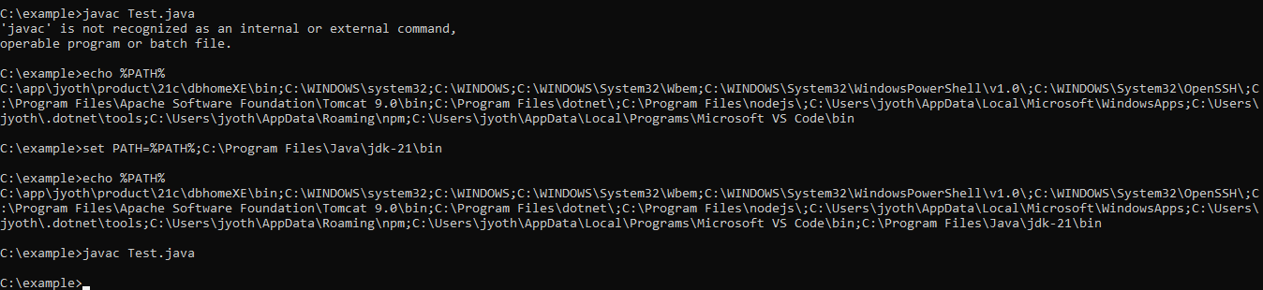
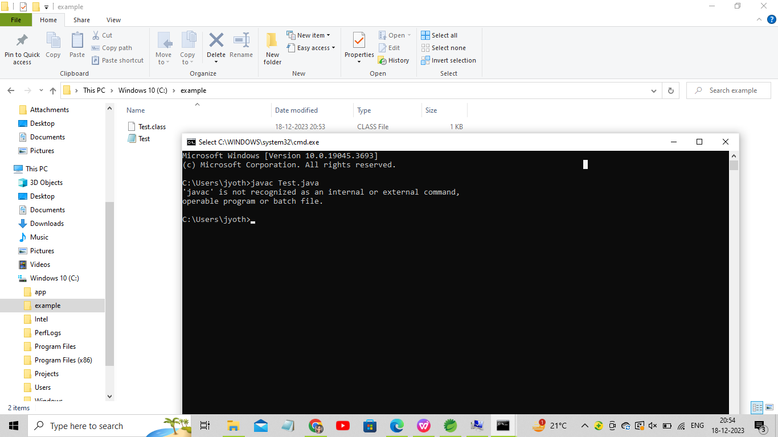
Setting up through CMD prompt
Command to know wheather the path has been set or not :
> echo %PATH%
Command to set the path :
> set PATH = %PATH% ; C:\Program Files\Java\jdk-21\bin

Slide 6

Setting up through environmental variables
Go To Settings
|
Click on environmental variables
|
Find the “Path Variable” under “System variables” and click “edit”
|
click “new” and add path upto “bin” directory
|.
for example : C:\Program Files\Java\jdk-21\bin
|
Apply changes . Click “Ok” and close the window

Slide 7
How to set CLASS PATH
Class Path :
Class Path is an environmental variable used by the system to locate and load the java byte codes which are stored in the .class files.
We can set the class path in two ways:
1. Through command prompt (temporary)
2. Through environmental variables (permanent)

Slide 8
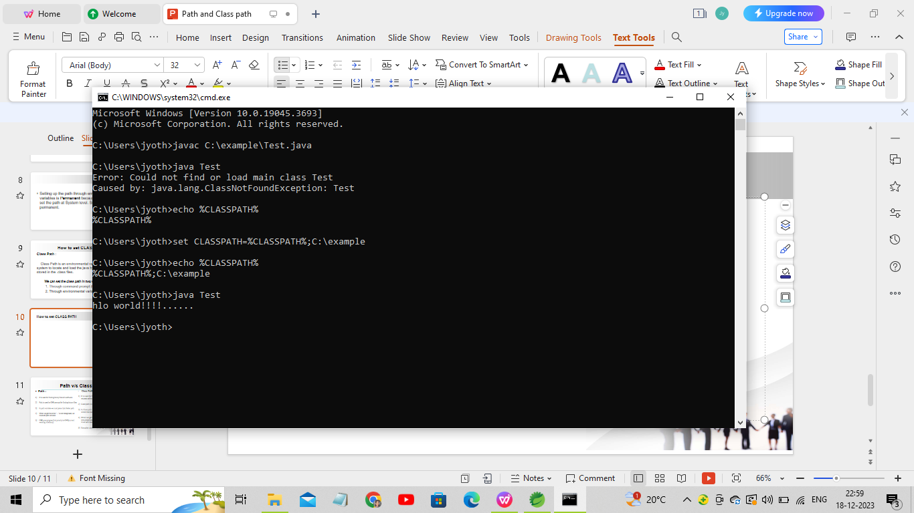
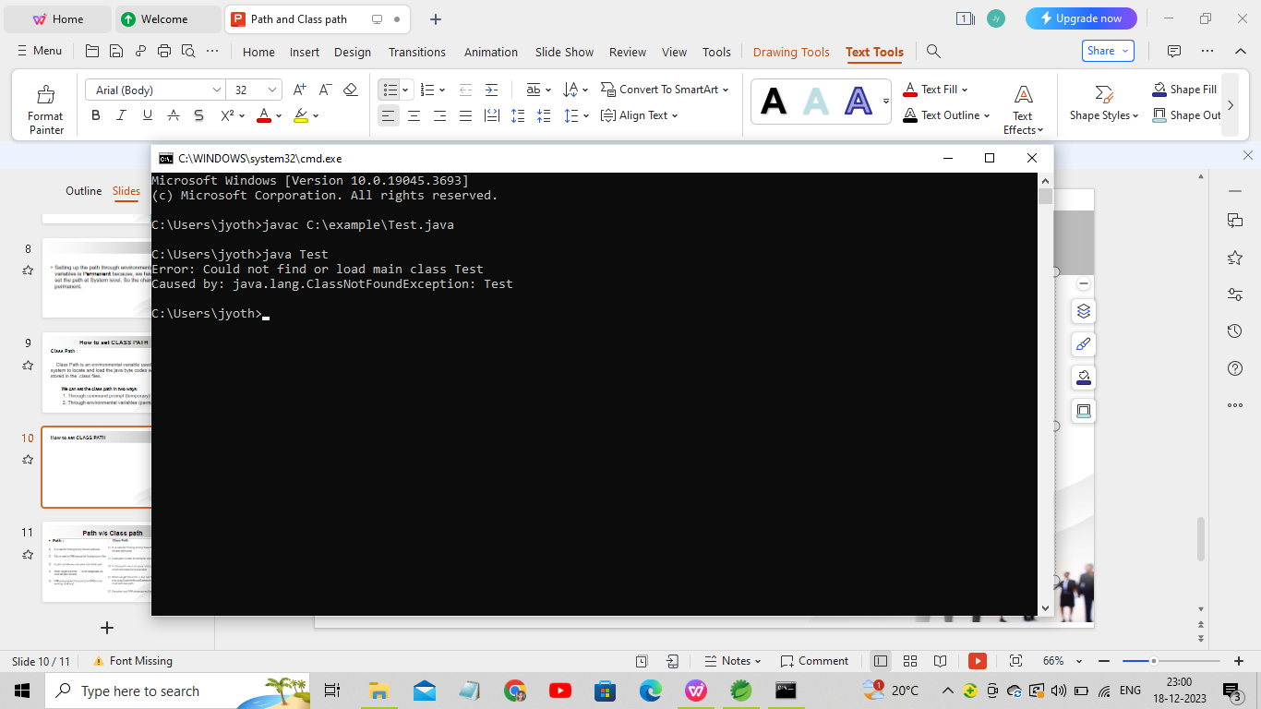
Setting up through CMD prompt
Command to know wheather the class path has been set or not :
> echo %CLASSPATH%
Command to set the class path :
> set CLASSPATH = %CLASSPATH% ; path(where .class files are present)

Slide 9
Setting up through environmental variables
Go To Settings
|
Click on environmental variables
|
click “new” under “System variables” and provide “variable name and value”
|
for example : variable name : CLASSPATH
variable value : Path(where .class files are present
|
Apply changes . Click “Ok” and close the window

Slide 10
Setting up Class Path in Eclipse
Right click on “Project” select “build path” and click “configure build path”
||
Select “Libraries” and select “Add External Jars” button
||
Browse through the folder where requried jars exists, select them and press open
||
Selected jar files will be added to Libraries. Finally press “Ok”
||
Now, if you open the “Referenced libraries” in project you can observe the added jar file.

Slide 11
Setting up the path/classpath through command prompt is Temporary because, whatever the path/classpath we have been set that can be applicable only within that command prompt.
If we open new command prompt then we can not find path/classpath, because changes made in one command prompt can not be applicable in another command prompt.
Setting up the path/classpath through environmental variables is Permanent because, we have been set the path/classpath at System level. So the changes will be permanent.

Slide 12
Path v/s Class path
Path :
It is used for finding binary files of a software
Path is used by CMD prompt for finding binary files
In path variable we must place .\bin folder path
When we get the error '---' is not recognized, we must set path variable
CMD prompt gives first priority to CWD(current working directory)
Class Path :
It is used for finding library files of Java and its related softwares
Class path is used by compiler and JVM to find library files
In Class path we must place .\lib\.jar file or directory path in which the class file is available
When we get the error -> can not find symbol class Test -> java.lang.ClassNotFoundException: Test then we must set class path
Compiler and JVM always gives first priority to Class path,

Slide 13
